Slide 1
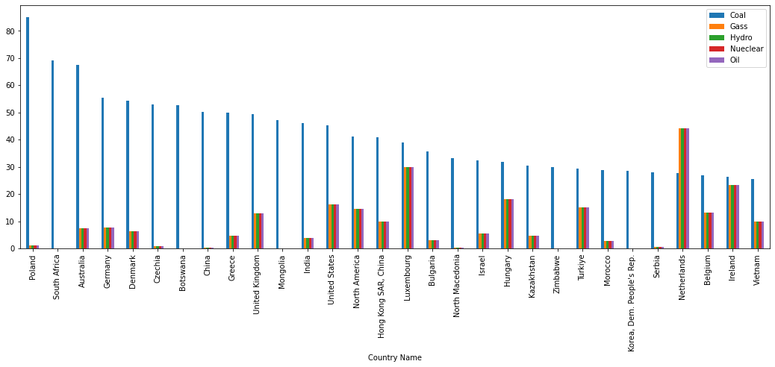
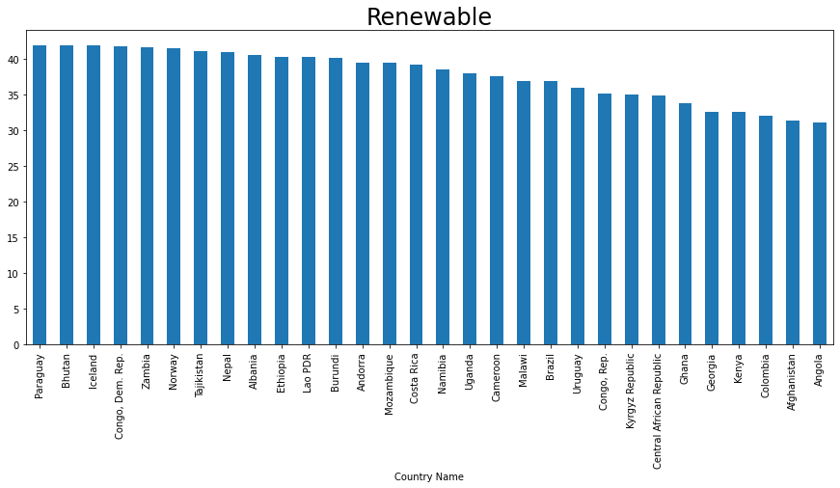
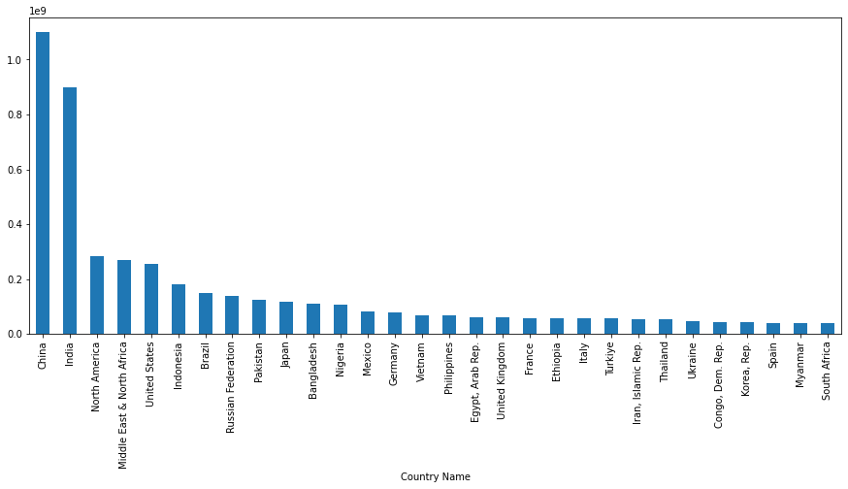
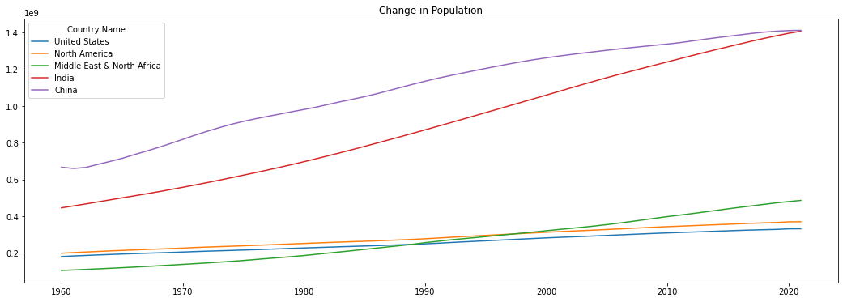
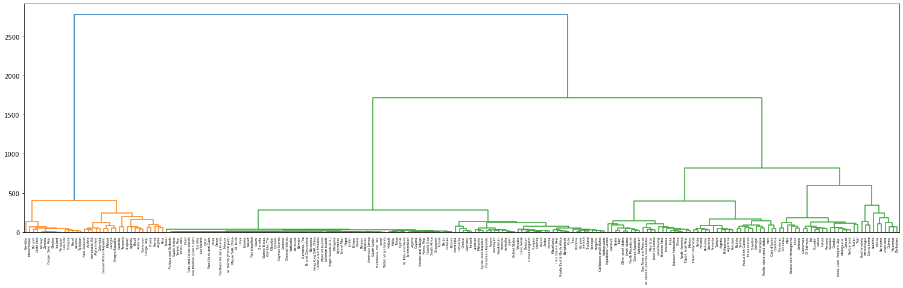
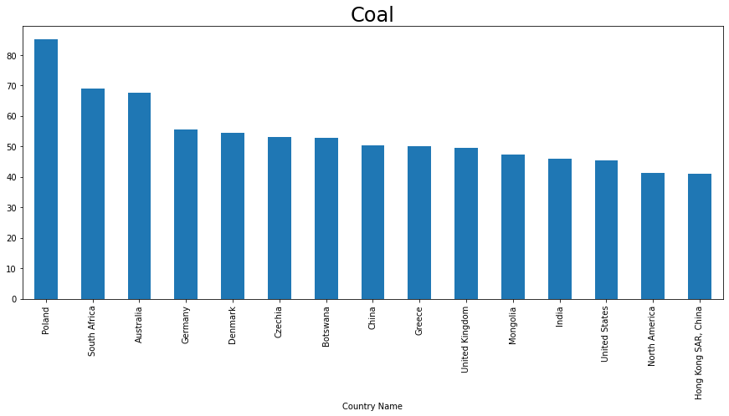
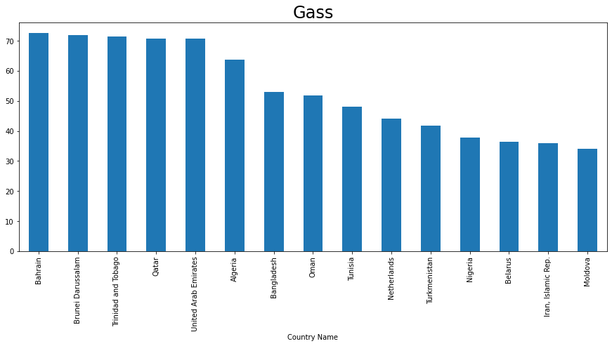
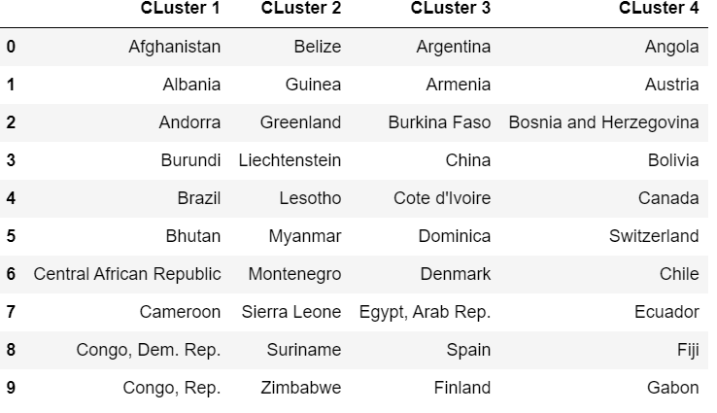
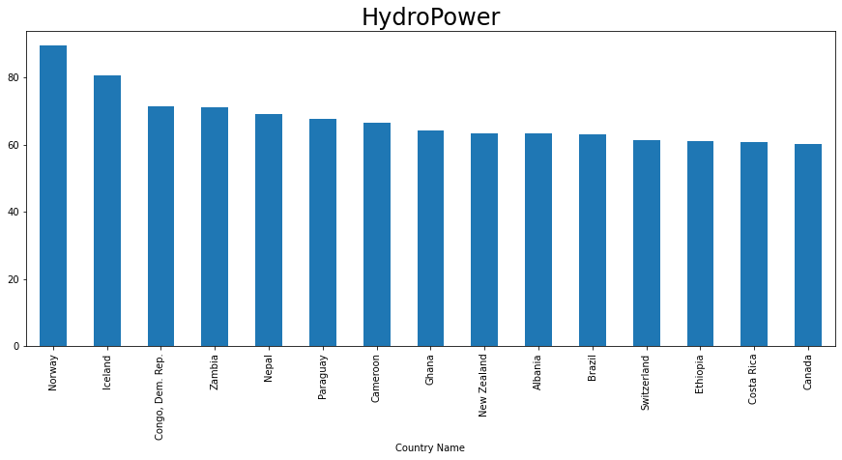
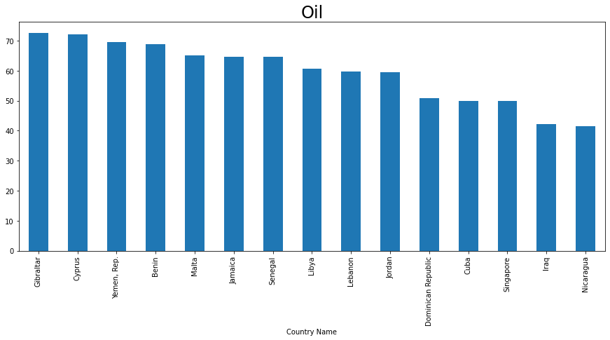
Electricity Production around the World
Introduction
Coal, natural gas, nuclear power, hydroelectricity, and renewable sources such as wind, solar, and geothermal energy are the primary sources of electricity production across the globe. The precise combination of these sources varies by country and area, with some countries relying largely on a single source and others using a combination of many sources.
China, for instance, is the largest power producer in the world and generates a considerable amount of its electricity from coal, but many European nations have switched towards increasing usage of renewable energy sources. In this project we will see how different countries around the world are producing electricity and for that I will be using World Bank dataset from 1960 to 2021.
Analysis
Before checking the production of electricity, I tried to see the countries with top population and for that graph is given below.
Let’s see the change in the population of top 5 countries.
The change in the population of China and India is very high.
Now let’s see the top countries that are using different non renewable sources to produce electricity.
From these plots we can see that different countries are using different portion of different sources to produce electricity.
Now let’s see which source is being used most for electricity production.
Let’s check top countries that are mostly producing electricity from renewable sources.
This plot is for top 30 countries that are producing most of their electricity from renewable sources.
Clustering
After that the clustering was done to merge the same countries into same cluster with respect to the usage of renewable sources for producing electricity. The plot is given below.
These results are from hierarchal clustering. Along with I also used Kmeans clustering on the same data and made the clusters.
Top 10 countries of each cluster are given below.
This was all analysis that I performed on data.
https://github.com/tashuchahal/7PAM2000-0901-2022_Assignment-3

